Slide 1


“上善
若水”
Jay Kumar (杰克)
Supervisor: Junming Shao (邵俊明)
计算机科学与工程学院

Slide 2
My Story (我的故事)
01
Why UESTC
02
Academic & Research Work
03
Social Activities
04
Career Plan

Slide 3
Why I came UESTC

Slide 4

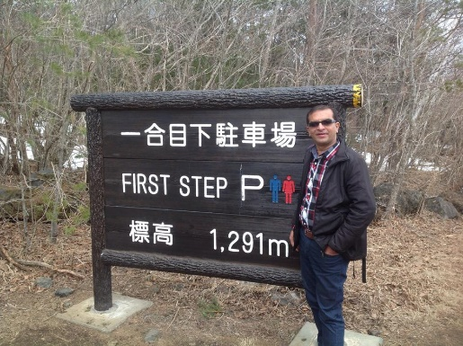
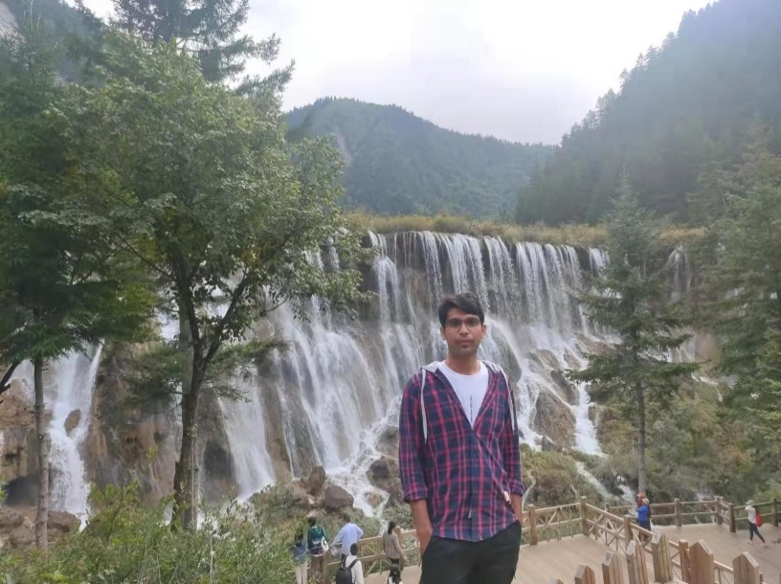


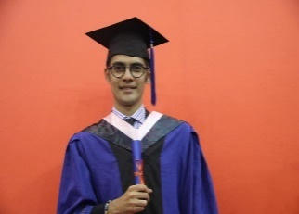
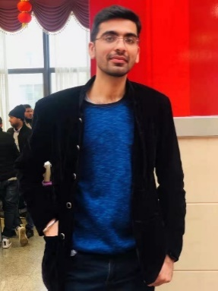



01
Why I Came
我的家人有很大的情感和热情来
2014
舅舅
2016
2017
哥哥
表哥
2018
2021
我
表妹

Slide 5
Academic & Research
(学术与研究)

Slide 6
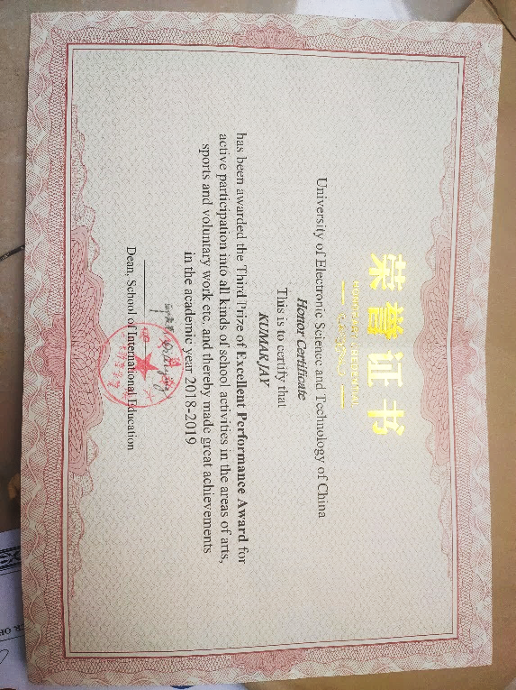
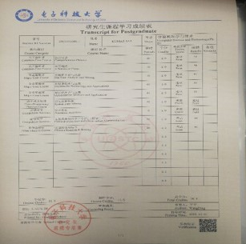
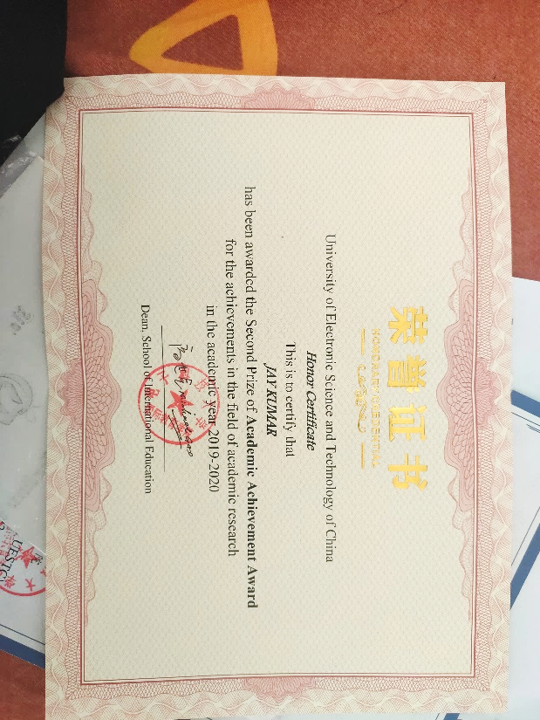
02
Academic Achievements
3rd Prize Excellent Performance
2018-2019
1st Prize Academic Achievement
2020-2021
2nd Prize Academic Achievement
2019-2020
综合汉语: 92
汉语阅读与写作: 96

Slide 7

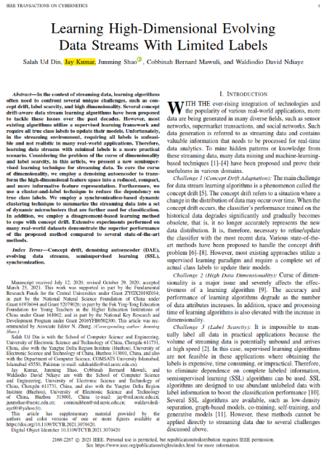
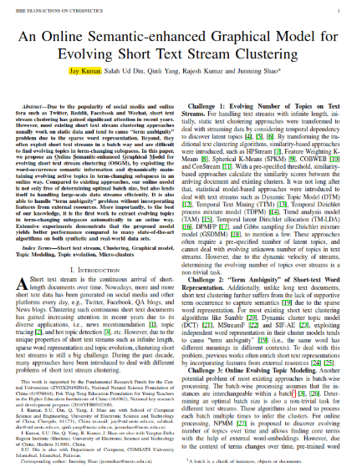
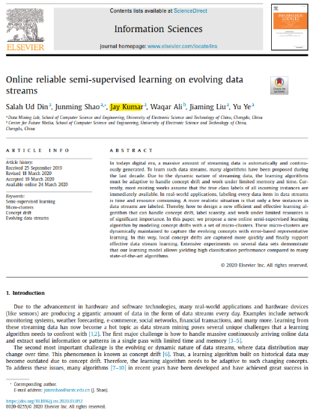
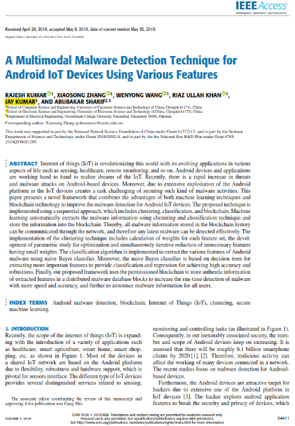
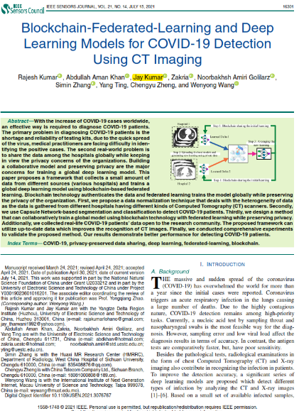
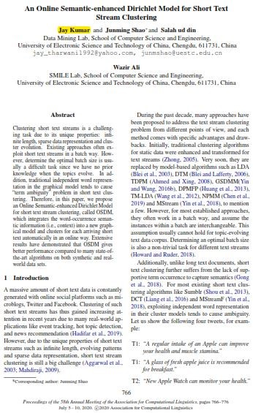
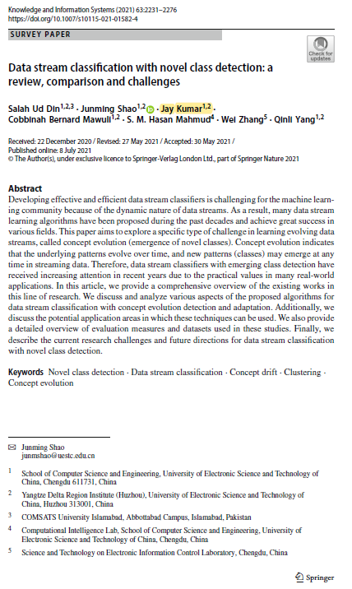
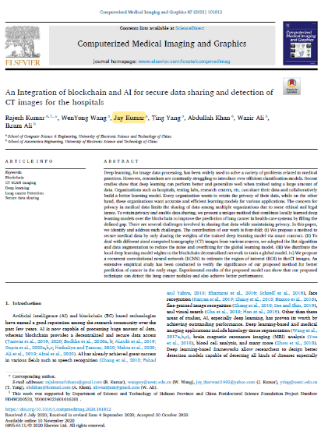
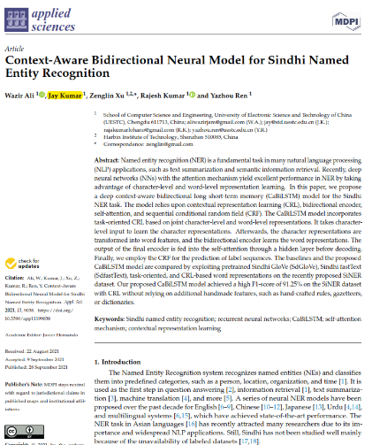
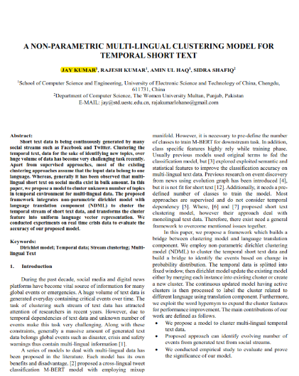
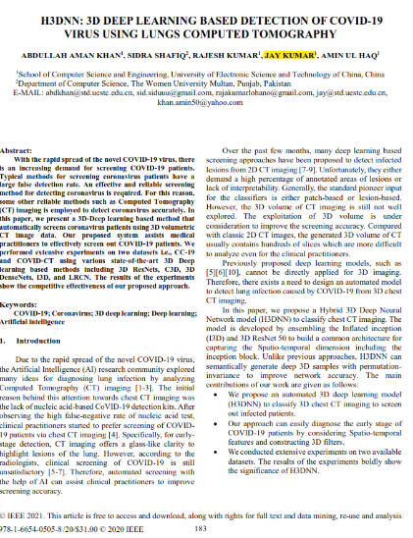
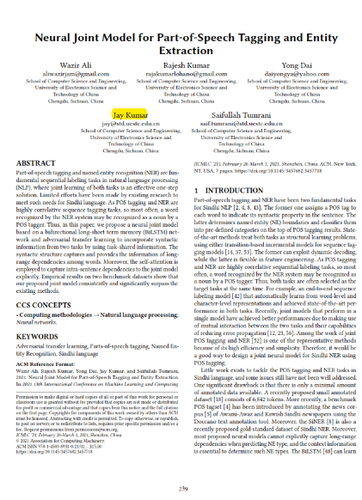
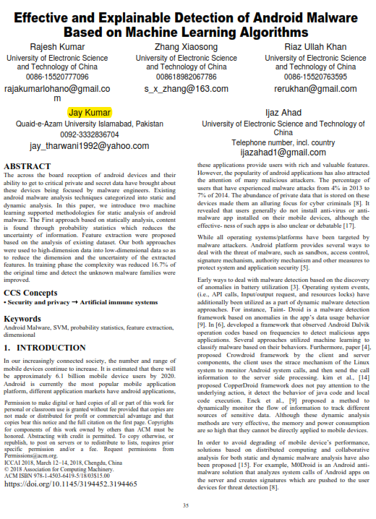
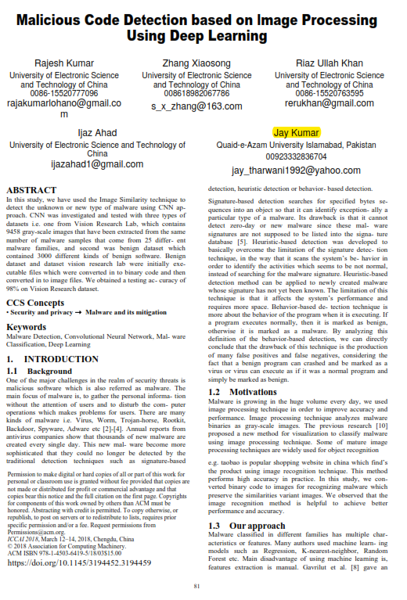
Research Works
02
An Online Semantic-Enhanced Graphical Model for Evolving Short Text Stream Clustering
影响因子
Impact factor 11.079
Kumar Jay et al. An Online Semantic-Enhanced Graphical Model for Evolving Short Text Stream Clustering.[J]. IEEE transactions on cybernetics, 2021, PP
12 Published/Accepted
Research Articles
3 中科院JCR-1区
（1篇第一作者）
1 CCF A
（第一作者）
EI
（1篇第一作者）
2 中科院JCR-2区
3 中科院JCR-3区

Slide 8

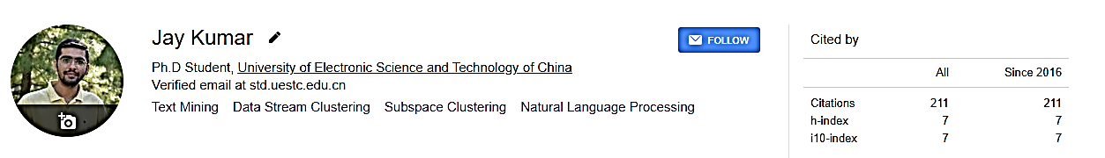
02
Research Works
12 Published/Accepted
46.69 Impact Factor
211 Citation Score
01 Under-review

Slide 9
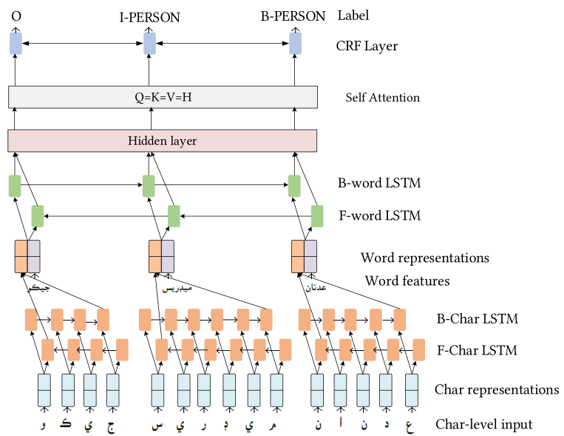
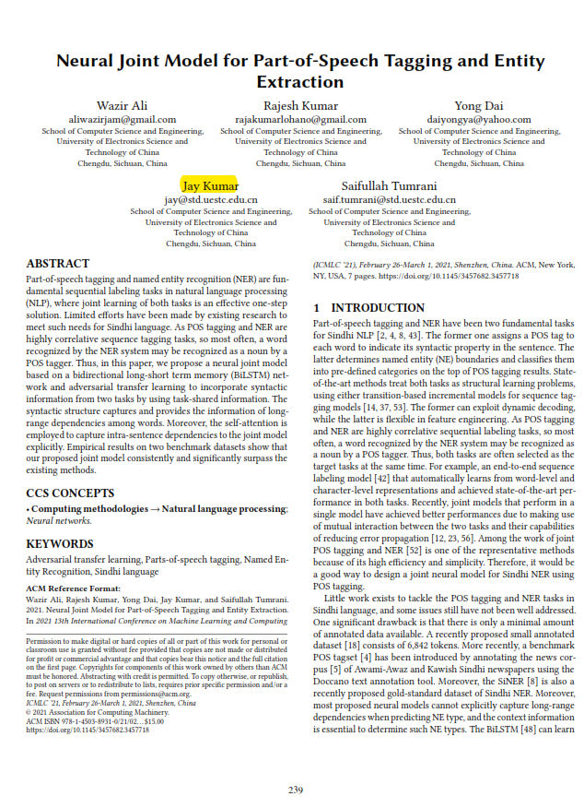
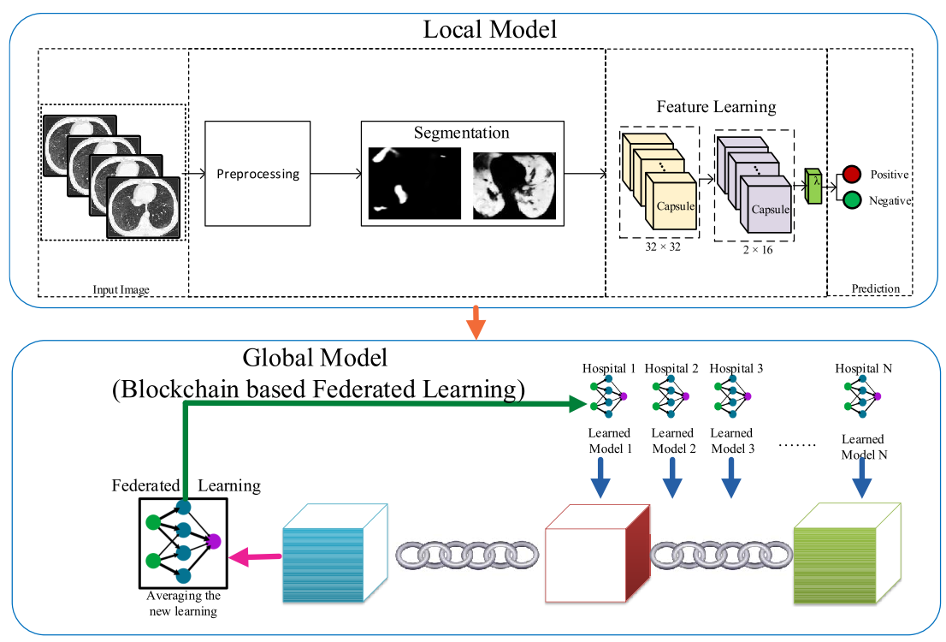
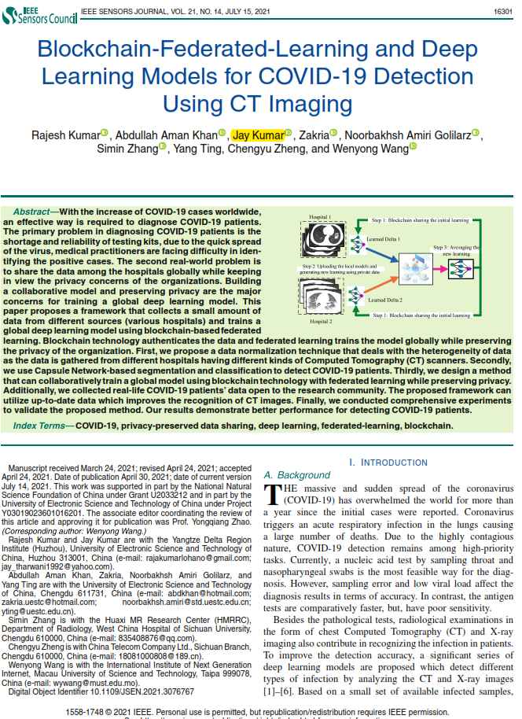


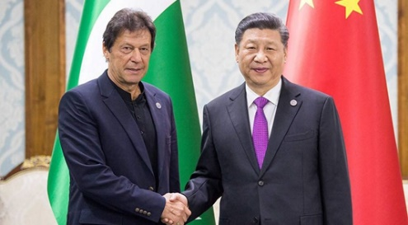
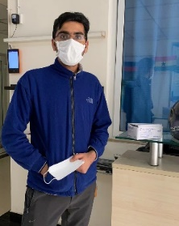
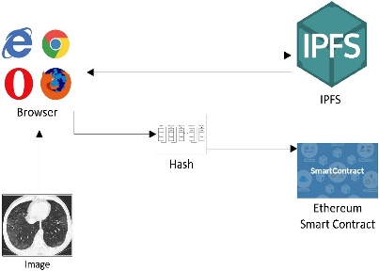
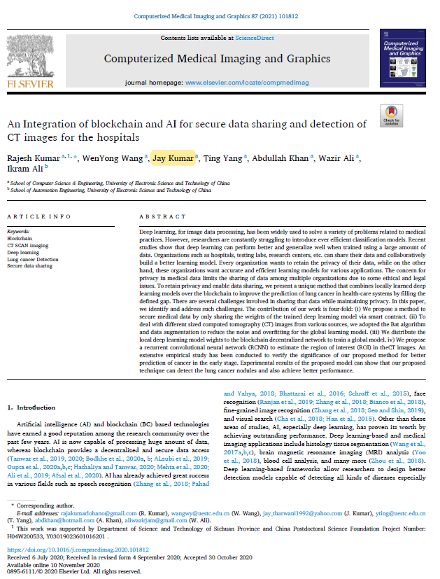
02
Important Research Works
Pak-China
Economic Corridor
Sindhi Language Translation
COVID-19 Detection on CT Imaging
Remove Communication Barrier
消 除 沟 通 障 碍
To help the humanity 帮 助 人 类

Slide 10
Social Activities
(社会活动)

Slide 11
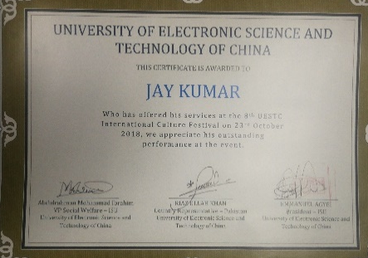
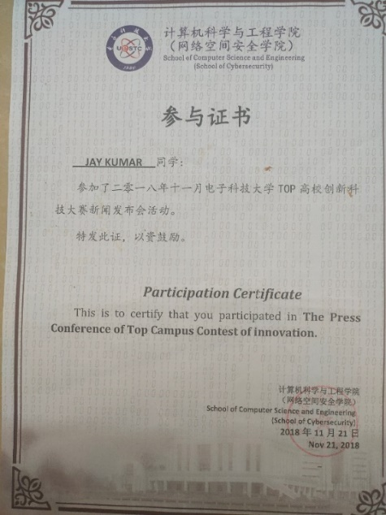
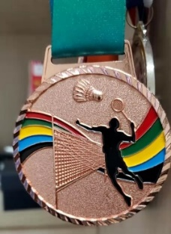
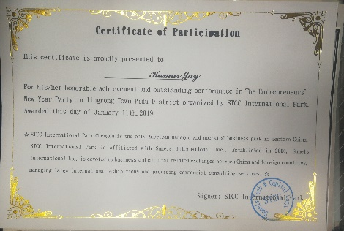
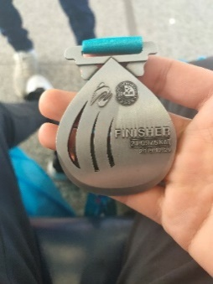
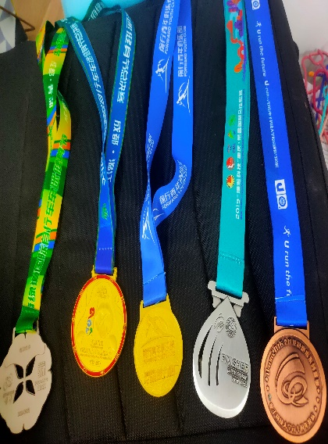
03
Social Activities
Conference Participation
Badminton Tournament Prizes
Cultural Dance Performance
21公里 Marathon
Volunteer Activity

Slide 12
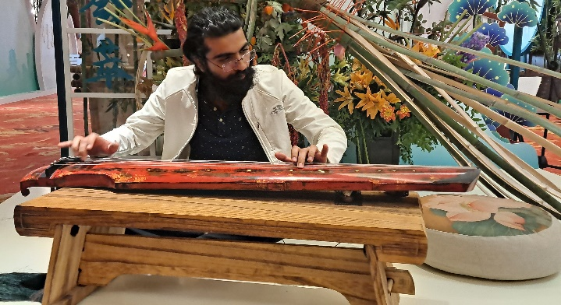
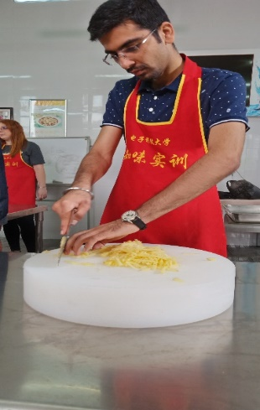
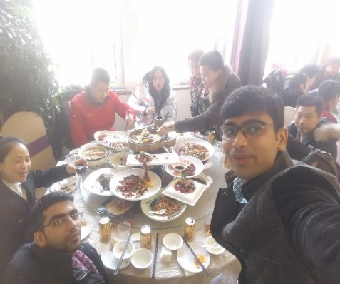
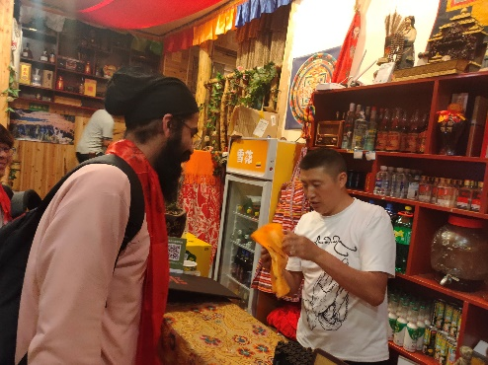
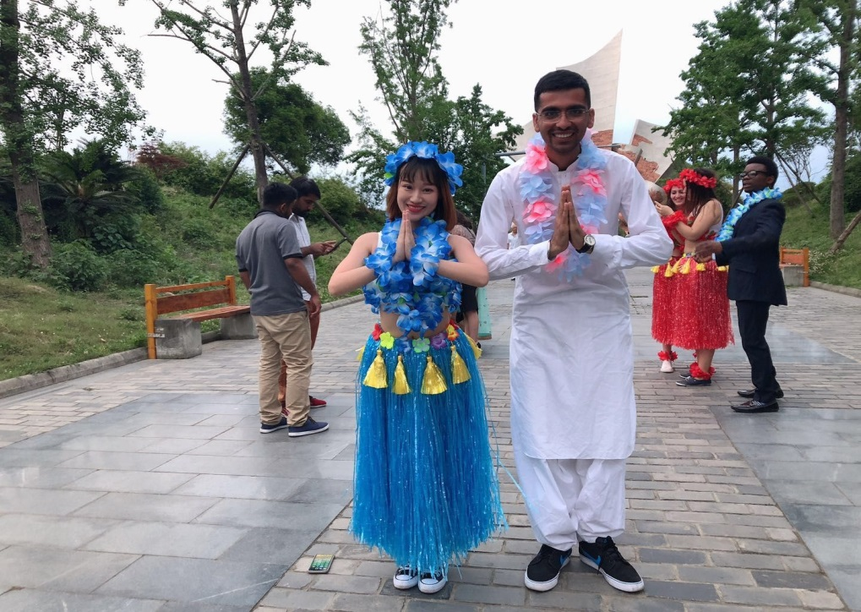
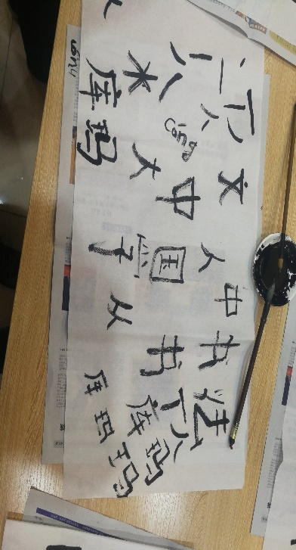
03
Life in China
1
2
3
AMAZING
CULTURE
AMAZING FOOD
AMAZING PEOPLE

Slide 13
Career Plan

Slide 14



03
Career Plan
Work in Academia
Work in Interdisciplinary Research
Read more Philosophy

Slide 15
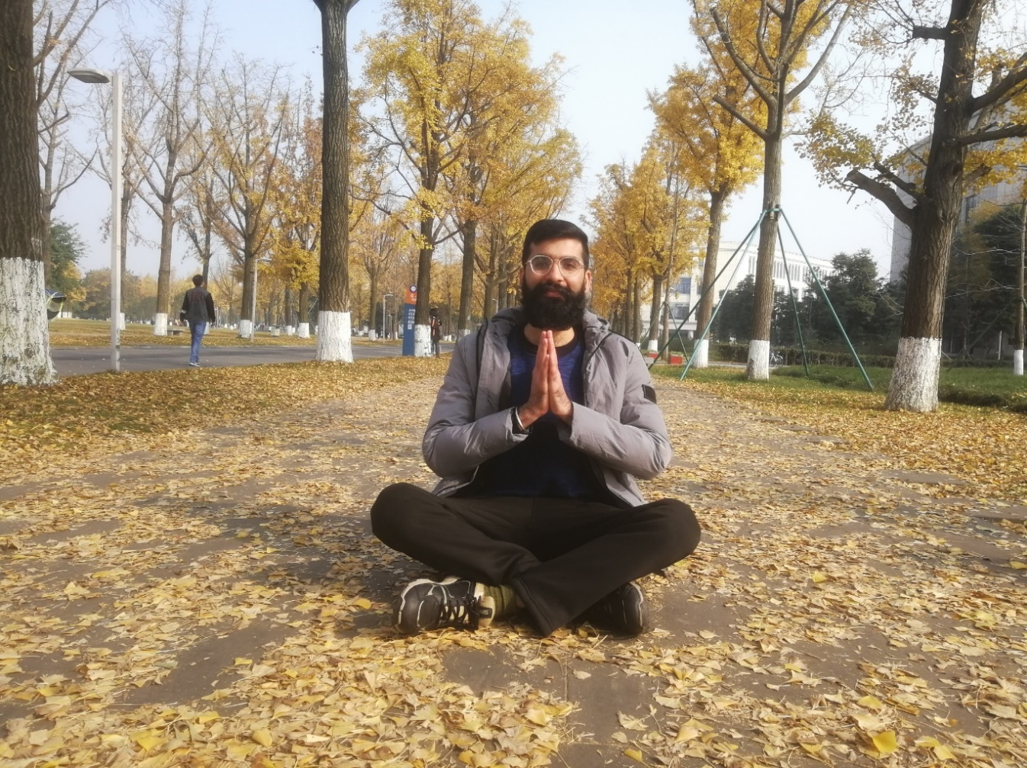
谢谢UESTC！
谢谢各位老师！
发表/接收文章12篇
（一作3篇，1 JCR-1，1 CCF A，已达到学校优博要求）
中科院JCR-1区文章 3篇（2篇影响因子11.079）
CCF-A类文章 1篇
中科院JCR-2区文章 2篇

